Slide 1

Lecture 5– Basics for Artificial Intelligence
Programming for Intelligent Web Services and Applications
Wenli Yang
yang.wenli@utas.edu.au

Slide 2
Unit Content
Programming for Intelligent Web Services and Applications
Web Programming
Intelligent Technologies
Advanced Web Research
Week1
Week5
Week9
Web Architecture
Classification and Clustering
Indexing and Ranking
Week2
Week6
Week10
Web Service Programming I
Natural Language Processing
Social media and network analysis
Week3
Week7
Week11
Web Service Programming II
Opinion Mining and Analysis
Conversational Chatbot
Week4
Week8
Week12
Web Monitoring and Mining
Recommendation Algorithms
Crowdsourcing
Week 13 – Unit Review (for Exam)

Slide 3
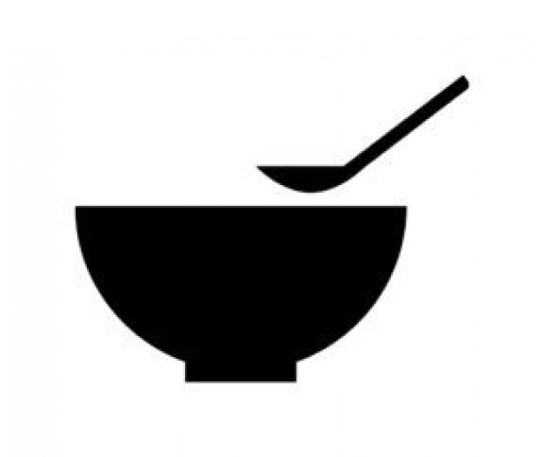
Data from Web service and applications
Web Architecture
Week1
Web Service (API)
Week2,3
Data
Data
Data
Data
Data
Data
Data
Data
Data
Data
Websites
Week4

Slide 4
Today’s Lecture
What data is useful for making the system intelligent?
What to do with this data in order to make the system intelligent?
Discover the knowledge from the data
Knowledge Discovery in Data/Database (KDD)
Discovering valid, novel, potentially useful, and ultimately understandable patterns (knowledge) in existing (historical) data

Slide 5
Knowledge Discovery in Data(base)
Knowledge Discovery in Data(base)
Discovering valid, novel, potentially useful, and ultimately understandable patterns (knowledge) in existing (historical) data
Setting the goal of KDD process
i.e. Will Wenli have dinner today?
Strategic decisions are supported.
i.e. Based on Wenli’s eating activity data in last 30 days, Wenli will skip dinner today
Training data (Historical data)
Prediction by using knowledge
KDD Process
Raw Historical Data (Information)
Knowledge (Pattern)

Slide 6
KDD Process
Notes:
Fall back to previous steps to improve that

Slide 7
KDD Process (1): Data Selection
Step 1: Data Selection - Select the target data
We DO NOT need all data for discovering the knowledge.
It is necessary to select only data that represents background knowledge.
Data selection is defined as the process of determining the appropriate data type and source, as well as suitable instruments to collect data..
The selected data are called ‘Target Data’
Raw Data
Target Data

Slide 8
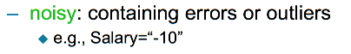
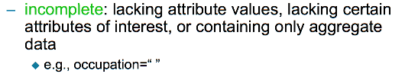
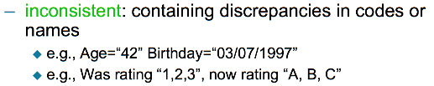
KDD Process (2): Data Pre-processing
Step 2: Data Pre-processing - Ensure that data is qualified
Most of data may contain noise, uncertainty, inconsistency. (i.e. incorrect or missing data)
Data pre-processing includes the cleaning of incorrect data, the treatment of missing data and the creation of new attributes
Target Data
Preprocessed Data
Notes:
Data cleaning, Compare the respondent's data to his data from previous year
Compare the respondent's data to data from similar respondents
Data reduction
Data wrangling

Slide 9
KDD Process (3): Data Transformation
Step 3: Data Transformation - Consolidate data into forms suitable for data mining
Data from different sources must be converted into a common format
Data may be encoded or generalised into more usable format.
Data transformation includes
Normalization (scale to within a specific range)
Mix-max (i.e. 0 to 1 )
Generalization (replace data with higher level concepts, i.e. latitude and longitude → suburb name)
Preprocessed Data
Transformed Data

Slide 10
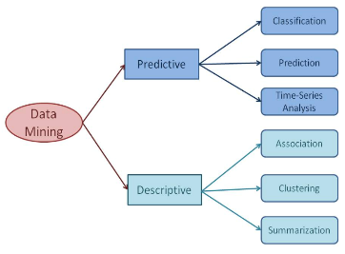
KDD Process (4): Data Mining
Step 4: Data Mining - use intelligent methods to extract patterns and knowledge from dataset
Now, all training data are ready
Training data: a set of historical data that use for discovering the pattern (knowledge).
Data mining Modeling Techniques
Predictive Modeling (Supervised Learning): using some variables to predict unknown or future values of other variables
Descriptive Modeling (Unsupervised Learning) finding human-interpretable patterns describing the data
Transformed Data
Pattern
Notes:
Supervised learning is where you have input variables (x) and an output variable (Y) and you use an algorithm to learn the mapping function from the input to the output.
The goal is to approximate the mapping function so well that when you have new input data (x) that you can predict the output variables (Y) for that data.
Unsupervised learning is where you only have input data (X) and no corresponding output variables.
The goal for unsupervised learning is to model the underlying structure or distribution in the data in order to learn more about the data.

Slide 11
KDD Process (5): Pattern Evaluation
Step 5: Pattern Evaluation - evaluate the patterns, which are the results of data mining process.
Checking whether the detected pattern from previous step (data mining) contain usable knowledge or not.
If the detected pattern is not interesting, it is necessary to fall back on a previous step
Pattern
Knowledge

Slide 12
KDD Process with example
Data Pre-processing
Data Selection
Data Transformation
Pattern Evaluation
Data Mining
If there is any incorrect or missing value in the selected target data
Collect the data from location API that can track the user’s location in 30 days
Using longitude and latitude is too complicated
Discovered a pattern using data mining techniques (classification or clustering)
Now, the training data is ready
Clean the incorrect value or Handle the missing value
Select only data source(i.e. latitude, longitude, time) that needed
Generalize longitude and latitude data into suburb name or place name
Evaluate the discovered pattern
Use Data mining techniques to mine the use pattern (knowledge)

Slide 13
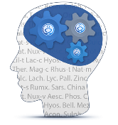
KDD Process with example
Web Application
with intelligence
Knowledge discovered from KDD process
Input
Output
What is the intelligence for system?
- The pattern (knowledge) that can use for predicting human’s behaviours or recommending human’s decision before the human acts

Slide 14
Data Mining Technique
Predictive Modelling
Have labels for some points
Want a rule that will accurately assign labels to new points
Method: Classification and Forecasting
Descriptive Modelling
No labels in data
Group points into clusters based on how “near” they are to one another
Method: Clustering

Slide 15
Classification
Find a model for class attribute as a function of the values of other(predictor) attributes, such that previously unseen records can be assigned a class as accurately as possible.
Most successful classification algorithms are as below:
Neural Networks
Nearest Neighbour (Kernel Estimation)
Decision Tree (Tree-based Classification)
Notes:
animal

Slide 16
Neural Network
Artificial neural network (ANN) is a machine learning approach that models human brain and consists of a number of artificial neurons.
Neuron in ANNs tend to have fewer connections than biological neurons. Each neuron in ANN receives a number of inputs.
Knowledge about the learning task is given in the form of examples called training examples
Many types of neural networks are available including Feed Forward Neural Network, Hopfield Neural Network, Simple Recurrent Network… Let’s have a look at the
Notes:
differentiates human brain from a simple machine. A simple machine is a set of algorithm, which converts input(s) to output(s).
Many types of neural networks are available including Feed Forward Neural Network, Hopfield Neural Network, Simple Recurrent Network , Radial Basis Function Network

Slide 17
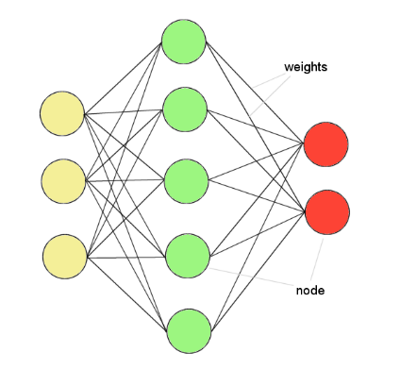
Neural Network
ANNs incorporate the two fundamental components of biological neural nets:
Neurones (nodes)
Synapses (weights)
Notes:
Like our human brain has millions of neurons in a hierarchy and Network of neurons which are interconnected with each other via Axons and passes Electrical signals from one layer to another called synapses.
Whenever we see, hear,feel and think something a synapse(electrical impulse) is fired from one neuron to another in the hierarchy which enables us to learn , remember and memorize things in our daily life since the day we were born.

Slide 18
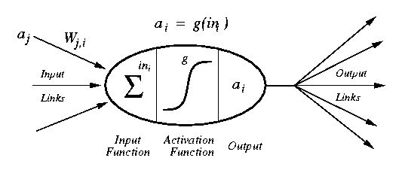
Neural Network
a_{j} :Activation value of unit j
w_{j,I} :Weight on the link from unit j to unit i
in_{I} :Weighted sum of inputs to unit i
a_{I} :Activation value of unit i
g :Activation function
Notes:
Their main purpose is to convert a input signal of a node in a A-NN to an output signal
we do the sum of products of inputs(X) and their corresponding Weights(W) and apply a Activation function f(x) to it to get the output of that layer and feed it as an input to the next layer.

Slide 19
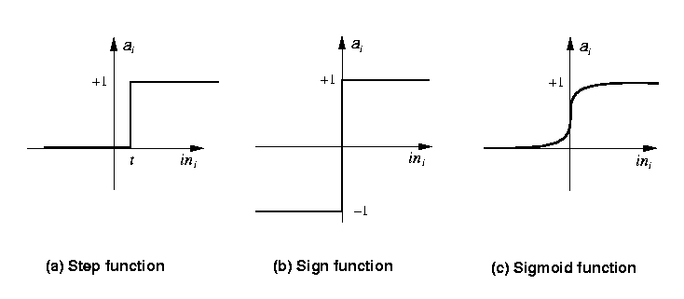
Activation Function
Step_{t}(x) = 1 if x >= t, else 0
Sign(x) = +1 if x >= 0, else –1
Sigmoid(x) = 1/(1+e^{-x})

Slide 20
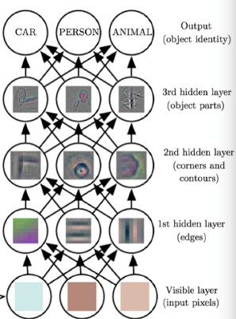
Feed Forward Neural Network
FFNN is the most common neural network architecture, where there are hidden layers between input and output layers.
Hidden nodes do not directly receive inputs nor send outputs to the external environment.
FFNNs overcome the limitation of single-layer NN.
They can handle non-linearly separable learning tasks.
Input
layer
Output
layer
Hidden Layer

Slide 21
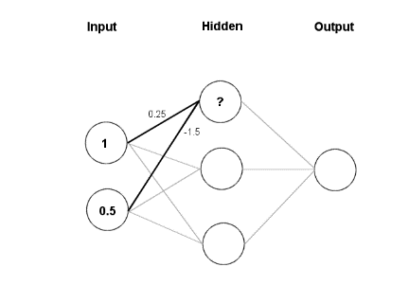
Feed Forward Neural Network
Feeding data through the net:
(1 × 0.25) + (0.5 × (-1.5)) = 0.25 + (-0.75) = - 0.5
Squashing:
Squashing:

Slide 22
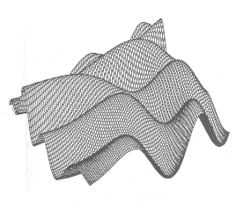
Neural Network
Weight settings determine the behaviour of a network
→ How can we find the right weights?
Training the Network - Learning
Backpropagation
Requires training set (input / output pairs)
Starts with small random weights
Error is used to adjust weights (supervised learning)
→ Gradient descent on error landscape
Notes:
Fitting a neural network involves using a training dataset to update the model weights to create a good mapping of inputs to outputs.

Slide 23
Neural Networks: Pros and Cons
Pros:
A neural network can be used to solve linear as well as non-linear programming tasks
An ANN can be used to solve classification, clustering, and regression related problems
Cons:
Most ANN's require a training phase to operate/function
Large ANN's require rather powerful HW to run (to accomplish reasonable execution times)
Notes:
number of input and outout layers and nuerons, and by selecting transfer functions

Slide 24
Nearest Neighbour Classifier
Learning by analogy: Tell me who your friends are and I’ll tell you who you are
To determine the class of a new example E:
Calculate the distance between E and all examples in the training set
Select K-nearest examples to E in the training set
Assign E to the most common class among its K-nearest neighbors
A new data is assigned to the most common class among the (K) examples that are most similar to it.

Slide 25
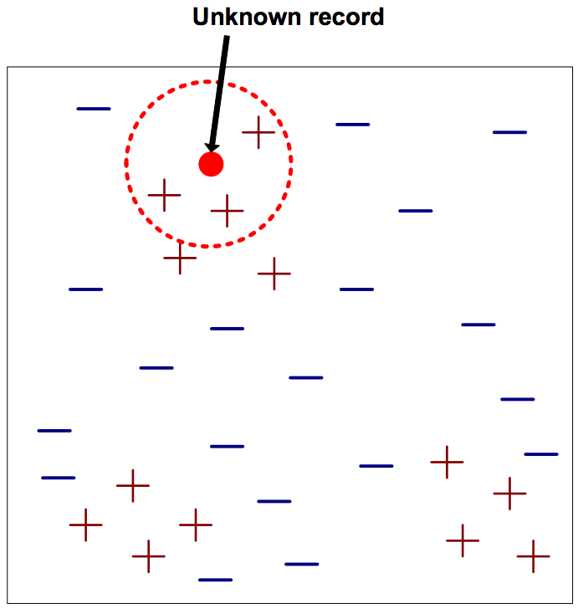
Nearest Neighbour Classifier
Requires three things
The set of stored records
Distance Metric to compute distance between records
The value of k, the number of nearest neighbors to retrieve

Slide 26
Nearest Neighbour: Example
Question: “Will Katy vote for Trump?”
Katy
Notes:
9

Slide 27
Nearest Neighbour: Pros and Cons
Pros:
Simple to implement and use
Comprehensible – easy to explain prediction
Robust to noisy data by averaging k-nearest neighbours.
Cons:
Takes more time to classify a new example than with a model (need to calculate and compare distance from new example to all other examples).
Detected results will be different according to the number of K

Slide 28
Decision Tree
A decision tree is a decision support tool that uses a tree-like graph or model of decisions and their possible consequences, including chance event outcomes, resource costs, and utility. It is one way to display an algorithm.
Decision trees are commonly used in operations research, specifically in decision analysis, to help identify a strategy most likely to reach a goal.
Pros : easy to understand the consequences(reason of the result): You can trace the result
Cons:
The high classification error rate while training set is small in comparison with the number of classes.
Exponential calculation growth while problem is getting bigger

Slide 29
Decision Tree
Nodes represent attribute tests
One child for each possible outcome of the test
Leaves represent classifications
Can have the same classification for several leaves
Classify by descending from root to a leaf
At each node perform the test and descend the appropriate branch
When a leaf is reached return the classification (action) of that leaf
Root node
C
Nodes of the tree
Leaves (terminal nodes) of the tree
Branches (decision point) of the tree
A
A
B
B
B
B

Slide 30
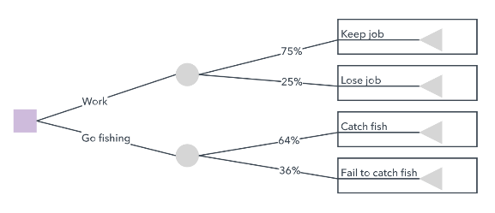
Decision Tree
Decision nodes
shows a decision to be made
Chance nodes
shows the probabilities of certain results.
End nodes
Shows the final outcome of a decision path.
Notes:
There are three different types of nodes: chance nodes, decision nodes, and end nodes

Slide 31
Decision Tree Example
Question: “How likely is person X to cheat?”
Training data
Decision Tree Model
Splitting Attribute
Refund
categorical
categorical
continuous
class
ID | Refund | Marital Status | Taxable Income | Cheat
1 | Yes | Single | 125K | No
2 | No | Married | 100K | No
3 | No | Single | 70K | No
4 | Yes | Married | 120K | No
5 | No | Divorced | 95K | Yes
6 | No | Married | 60K | No
7 | Yes | Divorced | 220K | No
8 | No | Single | 85K | Yes
9 | No | Married | 75K | No
10 | No | Single | 90K | Yes
Yes
No
No
Marital Status
Single, Divorced
Married
TaxInc
No
< 80K
> 80K
No
Yes

Slide 32
Apply Model to Test Data
Decision Tree Model
Test Data
Start from the root of tree
Refund
Refund | Marital Status | Taxable Income | Cheat
No | Married | 80K | ?
Yes
No
No
Marital Status
Single, Divorced
Married
TaxInc
No
< 80K
> 80K
No
Yes

Slide 33
Apply Model to Test Data
Decision Tree Model
Test Data
Refund
Refund | Marital Status | Taxable Income | Cheat
No | Married | 80K | ?
Yes
No
No
Marital Status
Single, Divorced
Married
TaxInc
No
< 80K
> 80K
No
Yes

Slide 34
Apply Model to Test Data
Decision Tree Model
Test Data
Refund
Refund | Marital Status | Taxable Income | Cheat
No | Married | 80K | ?
Yes
No
No
Marital Status
Single, Divorced
Married
TaxInc
No
< 80K
> 80K
No
Yes

Slide 35
Apply Model to Test Data
Decision Tree Model
Test Data
Refund
Refund | Marital Status | Taxable Income | Cheat
No | Married | 80K | ?
Yes
No
No
Marital Status
Single, Divorced
Married
TaxInc
No
< 80K
> 80K
No
Yes

Slide 36
Apply Model to Test Data
Decision Tree Model
Test Data
Refund
Refund | Marital Status | Taxable Income | Cheat
No | Married | 80K | ?
Yes
No
No
Marital Status
Single, Divorced
Married
TaxInc
No
< 80K
> 80K
No
Yes

Slide 37
Apply Model to Test Data
Decision Tree Model
Test Data
Refund
Refund | Marital Status | Taxable Income | Cheat
No | Married | 80K | ?
Yes
No
No
Marital Status
Single, Divorced
Married
Assign Cheat class to ‘No’
TaxInc
No
< 80K
> 80K
No
Yes

Slide 38
How to Specify Split Condition?
Depends on attribute types
Nominal
Ordinal
Numeric (continuous)
Depends on number of ways to split
Binary split
Multi-way split

Slide 39
Splitting in Decision Tree: Nominal
Multi-way split: use as many partitions as distinct values.
Binary split: divides values into two subsets; need to find optimal partitioning.
CarType
Family
Sports
Luxury
CarType
CarType
{Sport, Luxury}
{Family}
OR
{Family, Luxury}
{Sports}

Slide 40
Splitting in Decision Tree: Ordinal
Multi-way split: use as many partitions as distinct values.
Binary split: divides values into two subsets; need to find optimal partitioning.
Size
Small
Medium
Large
Size
Size
{Small, Medium}
{Large}
OR
{Medium, Large}
{Small}

Slide 41
Splitting in Decision Tree: Continuous
Different Options
Discretization to form an ordinal categorical attribute
Static – discretize once at the beginning
Dynamic – ranges found by equal interval bucketing, equal frequency bucketing (percentiles), or clustering.
Binary Decision: (A < v) or (A >= v)
Consider all possible splits, choose best one
Income >80K
Income
Yes
No
<40K
>80K
OR
{40K,80K}

Slide 42
How to determine the Best Split
Before Splitting: 10 records of class 0, 10 records of class 1
Which test condition is the best?

Slide 43
How to determine the Best Split
Greedy approach:
Nodes with homogeneous class distribution are preferred
Need a measure of node impurity:
Non-homogeneous,
High degree of impurity
Homogeneous,
Low degree of impurity

Slide 44
Splitting Criteria based on Classification Error
Classification error at a node t :
NOTE: p( i | t) is the relative frequency of class i at node t
Measures misclassification error made by a node.
Maximum (1 - 1/n_{c}) when records are equally distributed among all classes, implying least interesting information
Minimum (0.0) when all records belong to one class, implying most interesting information

Slide 45
Examples for Computing Error
P(C1) = 0/6 = 0 P(C2) = 6/6 = 1
Error = 1 – max (0, 1) = 1 – 1 = 0
P(C1) = 1/6 P(C2) = 5/6
Error = 1 – max (1/6, 5/6) = 1 – 5/6 = 1/6
P(C1) = 2/6 P(C2) = 4/6
Error = 1 – max (2/6, 4/6) = 1 – 4/6 = 1/3

Slide 46
Decision Tree: Pros and Cons
Pros:
very easy to explain to people.
Trees can be displayed graphically, and are easily interpreted even by non-expert.
Trees can easily handle qualitative predictors without the need to create dummy variables.
Cons:
trees generally do not have the same level of predictive accuracy as some of the other regression and classification approaches.

Slide 47
Clustering
Cluster
A cluster is a subset of objects which are “similar”
A subset of objects such that the distance between any two objects in the cluster is less than the distance between any object in the cluster and any object not located inside it
“Clustering” is a process partitioning a set of data (or objects)
Clustering can be used for answering following question: “Which group like our product X?”
Notes:
At least a single variable is required to perform clustering analysis. Clustering analysis with a single variable can be visualized with the help of a histogram

Slide 48
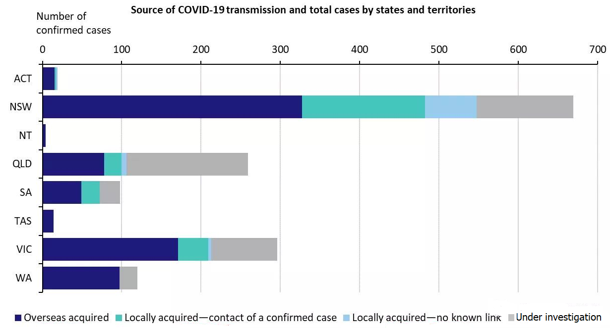
Clustering
The goal of data mining: “Which kind of people will have high risk?”
Data can be mined to compare the age and the medical history of the patients
Notes:
At least a single variable is required to perform clustering analysis. Clustering analysis with a single variable can be visualized with the help of a histogram.

Slide 49
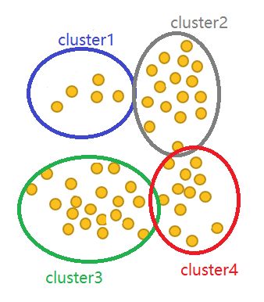
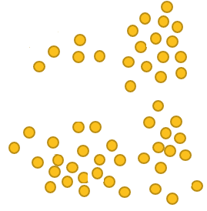
Clustering
Types of medical history
Types of Medical hostory
Age
Age
Notes:
At least a single variable is required to perform clustering analysis. Clustering analysis with a single variable can be visualized with the help of a histogram.

Slide 50
Clustering Model
There are two types of clustering modelling
Hierarchical Clustering
K-means Clustering

Slide 51
Hierarchical Clustering
Building a binary tree of the data that successively merges similar groups of points
Agglomerative: This is a "bottom up" approach: each observation starts in its own cluster, and pairs of clusters are merged as one moves up the hierarchy.
Divisive: This is a "top down" approach: all observations start in one cluster, and splits are performed recursively as one moves down the hierarchy.
c
a
b
h
e
d
a
b
d
e
f
c
g
h
f
g

Slide 52
Hierarchical Clustering
Bradley(1,6)
 | Bradley | Alex | Andrew | Theron
Bradley | 0 | 2 | 5 | 9
Alex | 2 | 0 | 3 | 7
Andrew | 5 | 3 | 0 | 4
Theron | 9 | 7 | 4 | 0
Romantic Movie Rating
Alex (1,4)
Andrew (1,1)
Theron (5,1)
Action Movie Rating

Slide 53
Hierarchical Clustering: Single Linkage
 | Bradley | Alex | Andrew | Theron
Bradley | 0 | 2 | 5 | 9
Alex | 2 | 0 | 3 | 7
Andrew | 5 | 3 | 0 | 4
Theron | 9 | 7 | 4 | 0
Bradley(1,4)
Alex(1,6)
Andrew (1,1)
Theron (5,1)
dist(Bradley,Alex),Andrew) = min(dist(Bradley,Andrew), dist(Alex,Andrew)
=min(3,5) =3
dist(Bradley,Alex),Theron) = min(dist(Bradley,Theron), dist(Alex,Theron)
=min(7,9) =7
dist(Andrew,Theron)=4

Slide 54
Hierarchical Clustering: Pros and Cons
Pros
It can produce an ordering of the objects, which may be informative for data display.
Smaller clusters are generated, which may be helpful for discovery
Cons
Use of different distance metrics for measuring distances between clusters may generate different results.

Slide 55
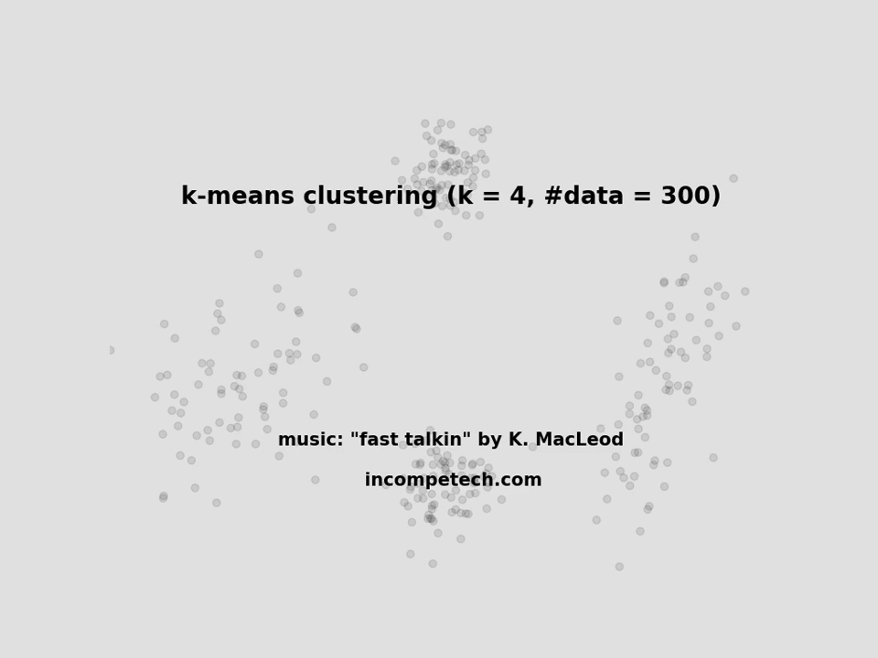
K-means clustering
The k-means algorithm is an algorithm to cluster n objects based on attributes into k groups, where k < n.
K-means clustering Process
Decide the number of clusters k
Initialize the center of the clusters
Attribute the closest cluster to each data point
Set the position of each cluster to the mean of all data points belonging to that cluster
Repeat steps 2-3 until convergence
Notes:
K-means clustering Process
Decide the number of clusters k
Initialize the center of the clusters
Attribute the closest cluster to each data point
Set the position of each cluster to the mean of all data points belonging to that cluster
Repeat steps 2-3 until convergence

Slide 56
K-means Clustering: Pros and Cons
Advantage
With a large number of variables, K-Means may be computationally faster than hierarchical clustering (if K is small).
Disadvantage
Difficulty in comparing quality of the clusters produced (e.g. for different initial partitions or values of K affect outcome).
Different initial partitions can result in different final clusters. It is helpful to rerun the program using the same as well as different K values, to compare the results achieved.

Slide 57
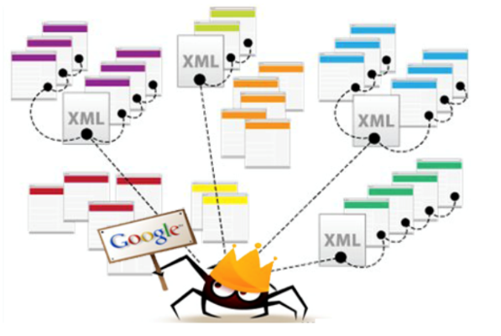
In this week,
We will learn how to collect data by web crawler

Slide 58










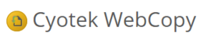
Web Crawler Tools

Slide 59
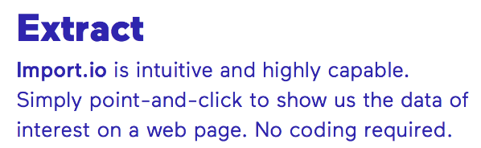

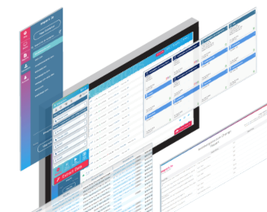
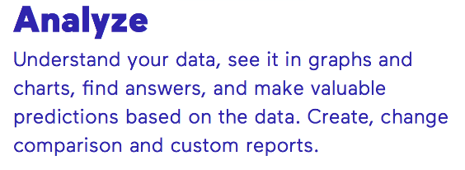
Import.io
Quick overview to get you started with Import.io extraction and queries

Slide 60
Octoparse
Octoparse is a powerful web scraping tools that can grab open data from almost all the websites. The features of Octoparse enables you to work with dynamic unstructured data by just clicking on single data points and Octoparse will generate efficient code to extract data automatically. No coding required.
Introduction of Octoparse
Notes:
A step-by-step guide on how to use Octoparse to make a crawler to deeply scrape data from each detail web page of the search results without having to know how to code. Yellow pages is use as an example here.

Slide 61
How do I make a simple crawler in PHP?
PHP Web Crawler is a software that searches for links in the web.
Feature:
Crawling is limited by depth setting or amount;
Full text search support;
As a general PHP script it allows running crawler manually from browser;
Notes:
How to Parse HTML DOM with PHP.
SSH access

Slide 62
How do I make a simple crawler in PHP?
QueryList is a simple, elegant, extensible PHP Web Scraper (crawler/spider) ,based on phpQuery.
Feature:
Have the same CSS3 DOM selector as jQuery
Have the same DOM manipulation API as jQuery
Have a strong HTTP request suite, easy to achieve
Have powerful content filtering, you can use the jQuey selector to filter content
Has a high degree of modular design, scalability and strong
Have an expressive API
Has a wealth of plug-ins;
Notes:
How to Parse HTML DOM with PHP.
SSH access

Slide 63
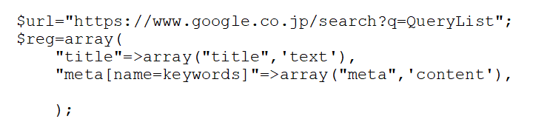
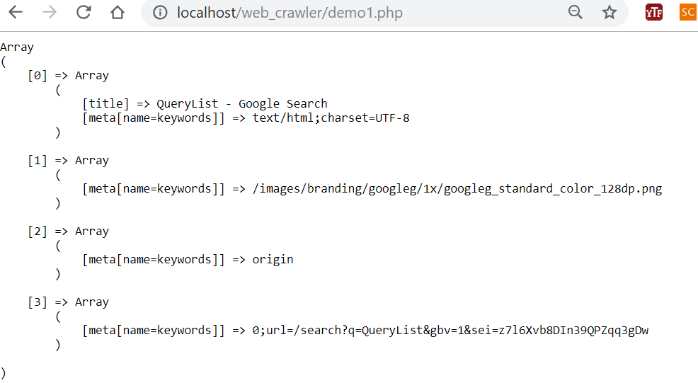
Usage
DOM Traversal and Manipulation
Crawl「Google search results」
Notes:
How to Parse HTML DOM with PHP.
SSH access

Slide 64
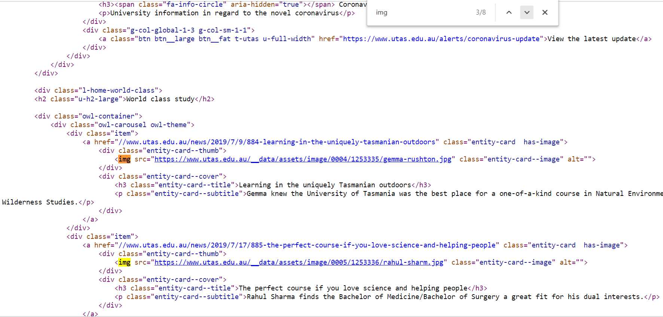
Usage
DOM Traversal and Manipulation
Crawl「UTAS」 image links
$url="http://www.utas.edu.au";
$reg=array( "img"=>array(".entity-card .entity-card--thumb img",'src'),
Notes:
How to Parse HTML DOM with PHP.
SSH access

Slide 65
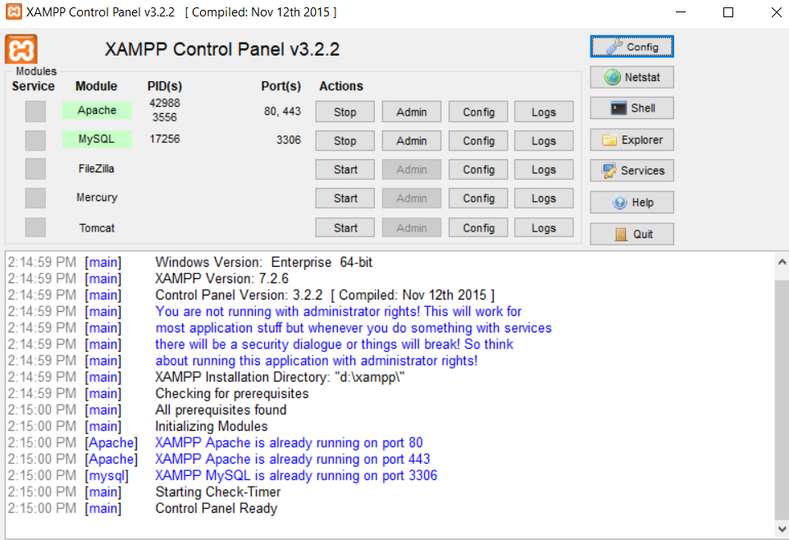
Run PHP in local sever (Xampp)

Slide 66
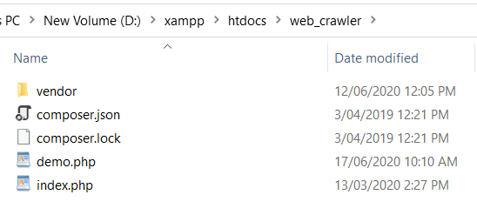
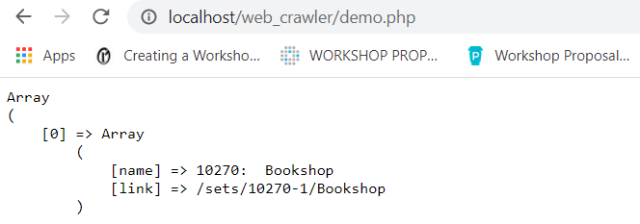
Run PHP in local sever (Xampp)
Copy the php file into “htdocs” file folder.
(Note: you can create sub file folder within htdocs file folder)
Run in the web browser using localhost address
(Note: related to your created file path)

Slide 67
Next week…
Lecture: Natural Language Processing.
Tutorial: Web crawling and web page segmentation
Weekly quiz: we will take a quiz about what we learn in week 5
(Basics of AI, Place API and News API)

